Slide 1
Machine Learning in Computational Chemistry:
Classification Models, Tree Models,
Introduction to Neural Networks
Jun Chen
Fujian Institute of Research on the Structure of Matter,
Chinese Academy of Sciences
July 15, 2025

Slide 2
Clustering

Slide 3
Clustering
Target : Find out the character of the dataset by obtaining clusters
Definition of cluster: G
Let T be a given positive number. If any two samples x_{i}, x_{j} in the set G satisfy d_{ij} ≤T
Figure: Example of Clustering

Slide 4
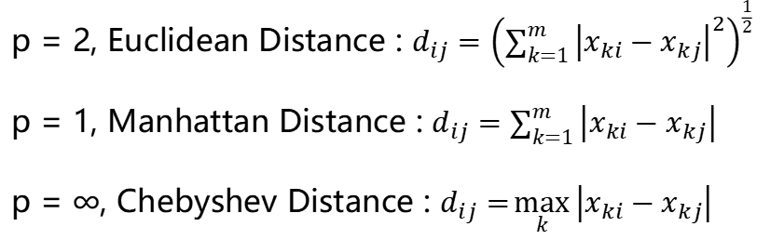

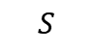
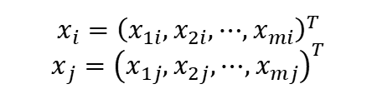
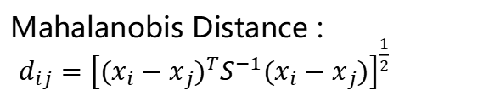
Clustering
Target : Find out the character of the dataset by obtaining clusters
Definition of cluster: G
Let T be a given positive number. If any two samples x_{i}, x_{j} in the set G satisfy d_{ij} ≤T
Kernel : Distance Metric, d_{ij}
Mahalanobis Distance :
$d_{ij}={\left[{(x_{i}−x_{j})}^{T}S^{−1}(x_{i}−x_{j})\right]}^{\frac{1}{2}}$
Minkowski Distance :$d_{ij}={\left(\sum_{k=1}^{m}{{\left|x_{ki}−x_{kj}\right|}^{p}}\right)}^{\frac{1}{p}}$
p = 2, Euclidean Distance : $d_{ij}={\left(\sum_{k=1}^{m}{{\left|x_{ki}−x_{kj}\right|}^{2}}\right)}^{\frac{1}{2}}$
p = 1, Manhattan Distance : $d_{ij}=\sum_{k=1}^{m}{\left|x_{ki}−x_{kj}\right|}$
p = ∞, Chebyshev Distance : $d_{ij}=\max_{k}\left|x_{ki}−x_{kj}\right|$
$$x_{i}={\left(x_{1i},x_{2i},⋯,x_{mi}\right)}^{T}$$
$$x_{j}={\left(x_{1j},x_{2j},⋯,x_{mj}\right)}^{T}$$
$$S$$
Covariance Matrix

Slide 5
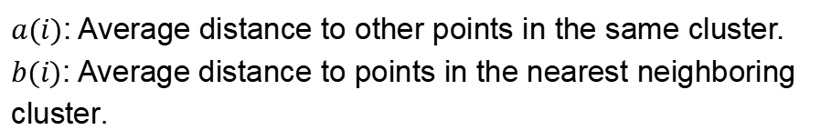
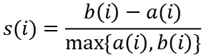
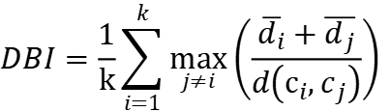
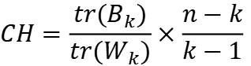
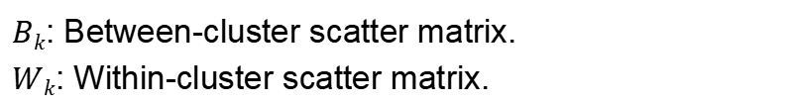
Evaluation Methods
Internal Evaluation Metrics
Silhouette Coefficient
$a(i)$: Average distance to other points in the same cluster.
$b(i)$: Average distance to points in the nearest neighboring cluster.
$$s(i)=\frac{b\left(i\right)−a(i)}{max⁡\{a\left(i\right),b\left(i\right)\}}$$
Calinski-Harabasz Index
$$CH=\frac{tr(B_{k})}{tr(W_{k})}×\frac{n−k}{k−1}$$
$Bk$: Between-cluster scatter matrix.
$Wk$​: Within-cluster scatter matrix.
Davies-Bouldin Index (DBI)
$$DBI=\frac{1}{k}\sum_{i=1}^{k}{\max_{j≠i}\left(\frac{\overline{d_{i}}+\overline{d_{j}}}{d\left(c_{i},c_{j}\right)}\right)}$$

Slide 6
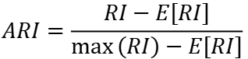
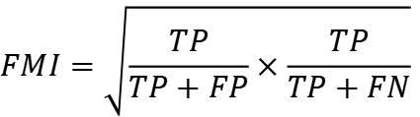
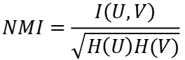
Evaluation Methods
External Evaluation Metrics
Adjusted Rand Index (ARI)
$$ARI=\frac{RI−E\left[RI\right]}{\max\left(RI\right)−E\left[RI\right]}$$
RI (Rand Index) = (TP + TN) / (TP + FP + FN + TN)
Normalized Mutual Information (NMI)
Fowlkes-Mallows Index (FMI)
$$NMI=\frac{I\left(U,V\right)}{\sqrt{H\left(U\right)H(V)}}$$
$$FMI=\sqrt{\frac{TP}{TP+FP}×\frac{TP}{TP+FN}}$$
$I$: Mutual information; $H$: Entropy

Slide 7
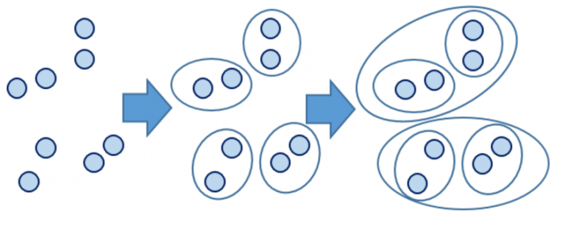
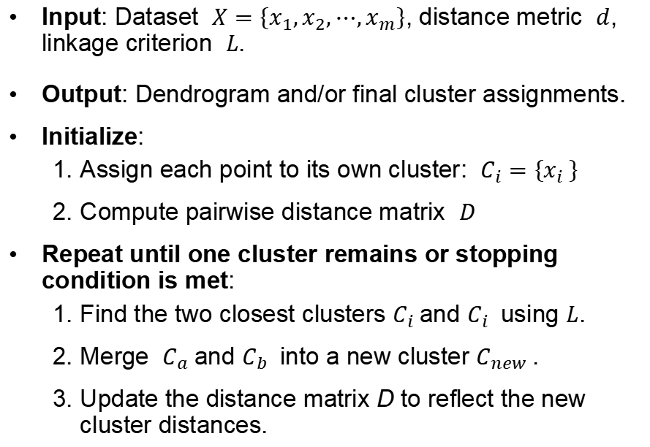
Agglomerative Clusteric
A bottom-up hierarchical clustering algorithm that iteratively merges similar data points or clusters to form larger groups.
Algorithm
Three Key Elements of Agglomerative Clustering:
Distance Metric
Linkage Criterion
Stopping Criterion
Input: Dataset $X=\left\{x_{1},x_{2},⋯,x_{m}\right\}$, distance metric $d$, linkage criterion $L$.
Output: Dendrogram and/or final cluster assignments.
Initialize:
Assign each point to its own cluster: $C_{i}=\left\{x_{i} \right\}$
Compute pairwise distance matrix $D$
Repeat until one cluster remains or stopping condition is met:
Find the two closest clusters $C_{i}$and​ $C_{i}$ using $L$.
Merge $C_{a}$and $C_{b}$ into a new cluster $C_{new}$​.
Update the distance matrix D to reflect the new cluster distances.
Figure: Figure for Agglomerative Clustering

Slide 8
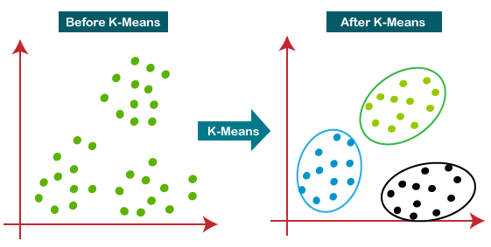
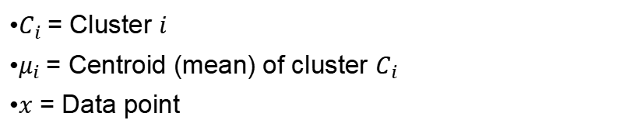
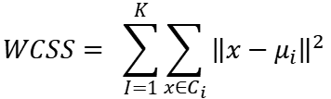
K-means
Partitioning data into K distinct, non-overlapping clusters.
Object
Minimizes the within-cluster sum of squares (WCSS)
$$WCSS= \sum_{I=1}^{K}{\sum_{x∈C_{i}}{{\left\|x−μ_{i}\right\|}^{2}}}$$
$C_{i}$= Cluster $i$
$μ_{i}$= Centroid (mean) of cluster $C_{i}$​
$x$ = Data point
Figure:Figure for K-means Clustering

Slide 9
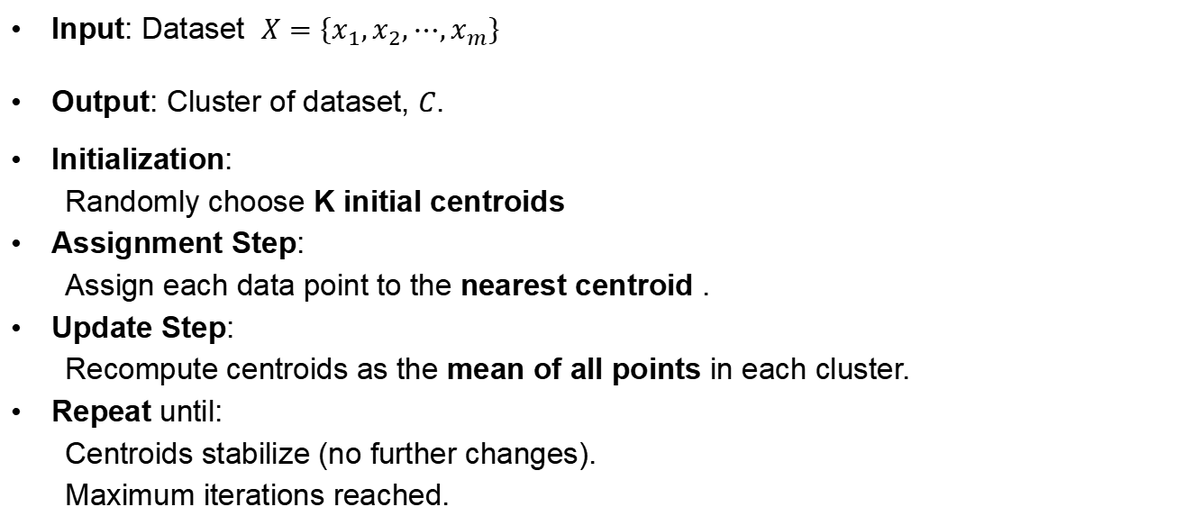
K-means
Partitioning data into K distinct, non-overlapping clusters.
Algorithm
Input: Dataset $X=\left\{x_{1},x_{2},⋯,x_{m}\right\}$
Output: Cluster of dataset, $C$.
Initialization:
Randomly choose K initial centroids
Assignment Step:
Assign each data point to the nearest centroid .
Update Step:
Recompute centroids as the mean of all points in each cluster.
Repeat until:
Centroids stabilize (no further changes).
Maximum iterations reached.

Slide 10
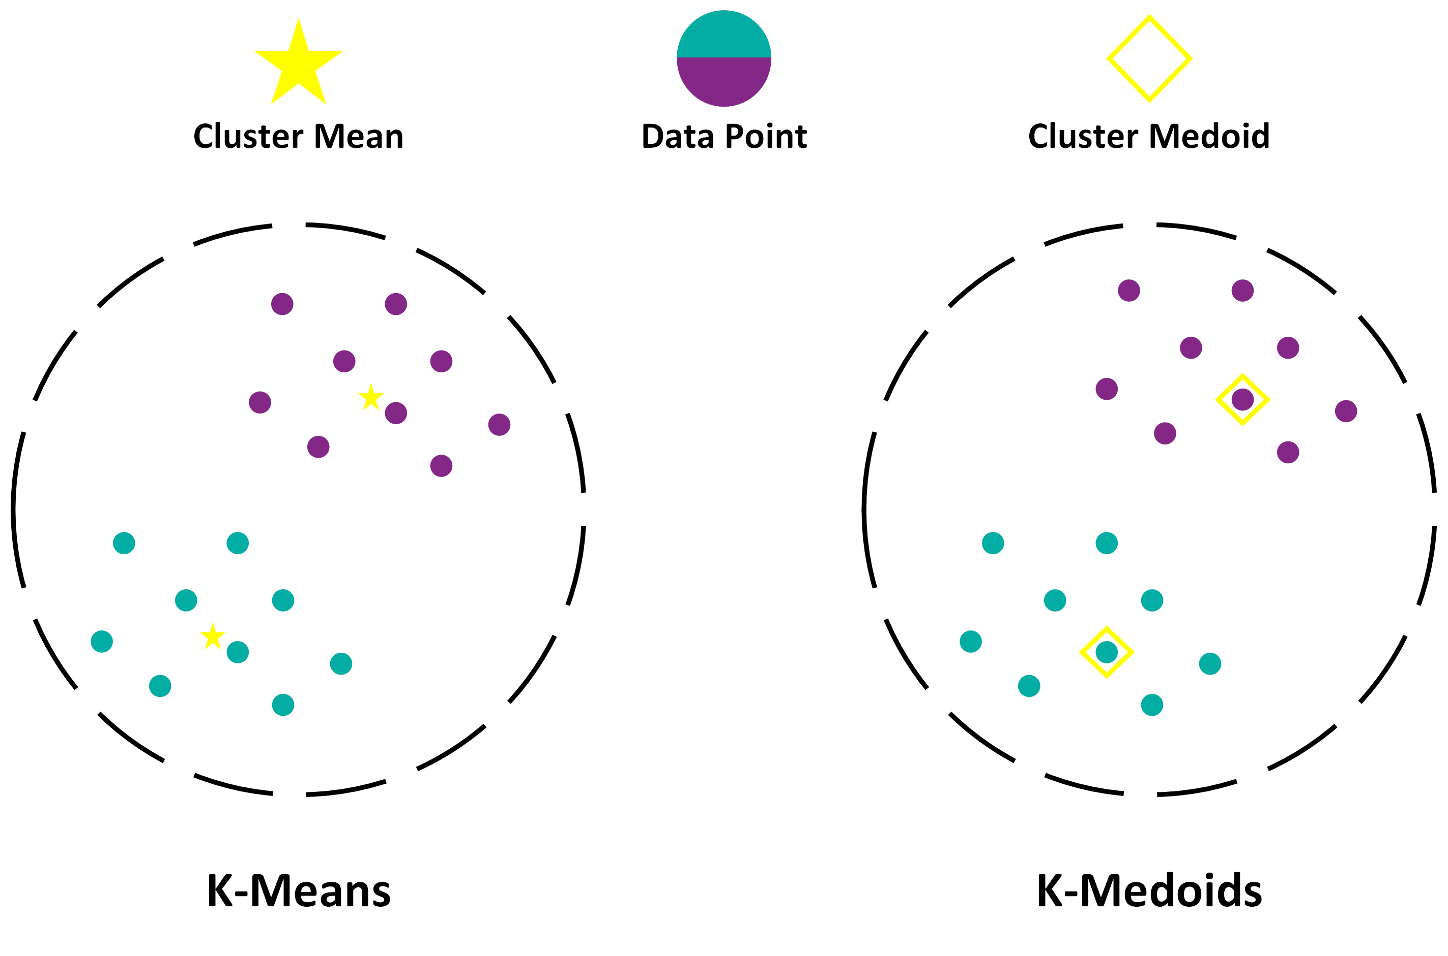
K-medoids
The basic strategy of k-medoids algorithm is each cluster is represented by one of the objects located near the center of the cluster
Algorithm
Initialization:
Randomly select K medoids.
Assignment Step:
Assign each point to the nearest medoid.
Update Step (Swap Phase):
For each medoid mm, try replacing it with a non-medoid point.
If swapping reduces the Total Dissimilarity Cost (TD), keep the swap.
Repeat until:
Medoids stabilize (no further improvements in TD).
Maximum iterations reached.

Slide 11
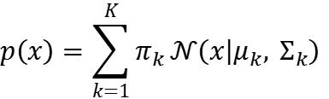
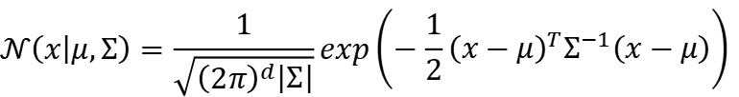
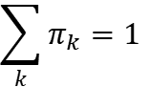
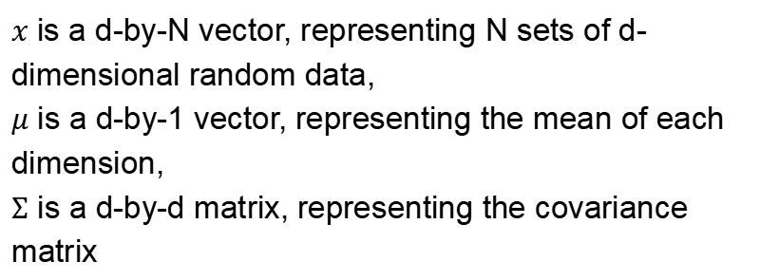
Gaussian Mixture Model (GMM)
Gaussian Mixture Models (GMM) is a probabilistic unsupervised learning algorithm that assumes data is generated from a mixture of K Gaussian distributions (also called components).
Gaussian Distribution
Mixture Model
$$𝒩\left(x | μ,Σ\right)=\frac{1}{\sqrt{{\left(2π\right)}^{d}\left|Σ\right|}}exp\left(−\frac{1}{2}{\left(x−μ\right)}^{T}Σ^{−1}\left(x−μ\right)\right)$$
$$p\left(x\right)=\sum_{k=1}^{K}{π_{k}}𝒩\left(x | μ_{k}, Σ_{k}\right)$$
$x$ is a d-by-N vector, representing N sets of d-dimensional random data,
$μ$ is a d-by-1 vector, representing the mean of each dimension,
$Σ$ is a d-by-d matrix, representing the covariance matrix
$$\sum_{k}{π_{k}}=1$$

Slide 12

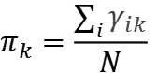
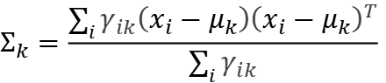
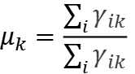
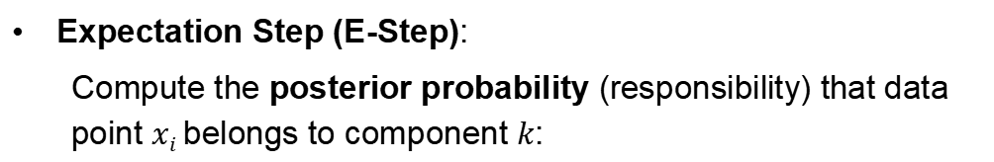
Gaussian Mixture Model (GMM)
Algorithm
Initialization: Randomly set means $μk​$, covariances $Σk$​, and weights $πk$​.
Expectation Step (E-Step):
Compute the posterior probability (responsibility) that data point $xi​$belongs to component $k$:
$$γ_{ik}=\frac{π_{k}𝒩\left(x_{i} | μ_{k}, Σ_{k}\right)}{\sum_{j=1}^{K}{π_{j}𝒩\left(x_{j} | μ_{j}, Σ_{j}\right)}}$$
Maximization Step (M-Step):
Update parameters to maximize the likelihood:
$$μ_{k}=\frac{\sum_{i}{γ_{ik}}}{\sum_{i}{γ_{ik}}}$$
$$Σ_{k}=\frac{\sum_{i}{γ_{ik}\left(x_{i}−μ_{k}\right){\left(x_{i}−μ_{k}\right)}^{T}}}{\sum_{i}{γ_{ik}}}$$
$$π_{k}=\frac{\sum_{i}{γ_{ik}}}{N}$$
Repeat until convergence

Slide 13
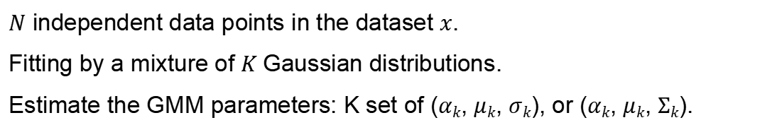
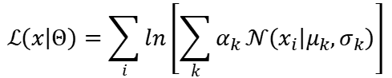
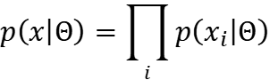
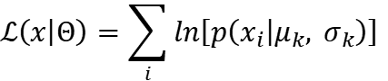
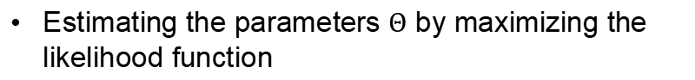
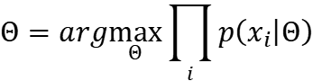
Expectation Maximization (EM)
The expectation-maximization(EM) algorithm is an iterative supervised training algorithm.
Object:
$N$ independent data points in the dataset $x$.
Fitting by a mixture of $K$Gaussian distributions.
Estimate the GMM parameters: K set of ($αk$​, $μk$​, $σk$​), or ($αk​$, $μk$​, $Σk$​).
Maximum-likelihood Estimation (MLE)
Simplified by log likelihood function
$$p\left(x | Θ\right)=\prod_{i}{p\left(x_{i} | Θ\right)}$$
$$ℒ\left(x | Θ\right)=\sum_{i}{ln\left[p\left(x_{i} | μ_{k}, σ_{k}\right)\right]}$$
Estimating the parameters $Θ$ by maximizing the likelihood function
$$ℒ\left(x | Θ\right)=\sum_{i}{ln\left[\sum_{k}{α_{k}}𝒩\left(x_{i} | μ_{k},σ_{k}\right)\right]}$$
$$Θ=arg\max_{Θ}{\prod_{i}{p\left(x_{i} | Θ\right)}}$$

Slide 14
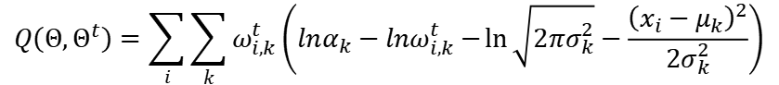
Expectation Maximization (EM)
The expectation-maximization(EM) algorithm is an iterative supervised training algorithm.
Algorithm:
Expectation Step (E-Step):
Estimate the latent parameters for each training sample on K Gaussian models
Calculate the Q-function (expected log-likelihood).
Maximization Step (M-Step):
Update parameters by maximizing the Q-function
Repeat until convergence (log-likelihood stabilizes).
$$Q\left(Θ,Θ^{t}\right)=\sum_{i}{\sum_{k}{ω_{i,k}^{t}}\left(lnα_{k}−lnω_{i,k}^{t}−\ln{\sqrt{2πσ_{k}^{2}}}−\frac{{\left(x_{i}−μ_{k}\right)}^{2}}{2σ_{k}^{2}}\right)}$$

Slide 15
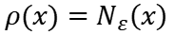
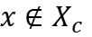
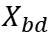
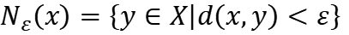
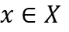
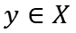
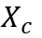
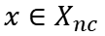
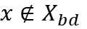
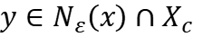
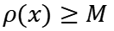
Density-Based Spatial Clustering of Applications with Noise (DBSCAN)
DBSCAN is a density-based clustering algorithm that groups together data points that are closely packed (high density) and marks outliers as noise.
Does not require predefining the number of clusters.
Can discover arbitrarily shaped clusters (e.g., spirals, moons).
Is robust to noise and outliers.
Core Concepts
Epsilon (ε, eps): Radius of the neighborhood around a point
border-point
Condition: if
$$x∈X_{nc}$$
and
$$y∈X$$
density
$$N_{ε}\left(x\right)=\left\{y∈X | d\left(x,y\right)<ε\right\}$$
satisfied
$$y∈N_{ε}\left(x\right)∩X_{c}$$
$$ρ(x)=N_{ε}\left(x\right)$$
noise-point
core point
$$x∈X$$
,
$$x∉X_{c}$$
and
$$x∉X_{bd}$$
$$x∈X$$
$$X_{c}$$
Set of core points
$$ρ(x)≥M$$
$M$ for the neighborhood density threshold of clustering
$$X_{bd}$$
Set of border points

Slide 16
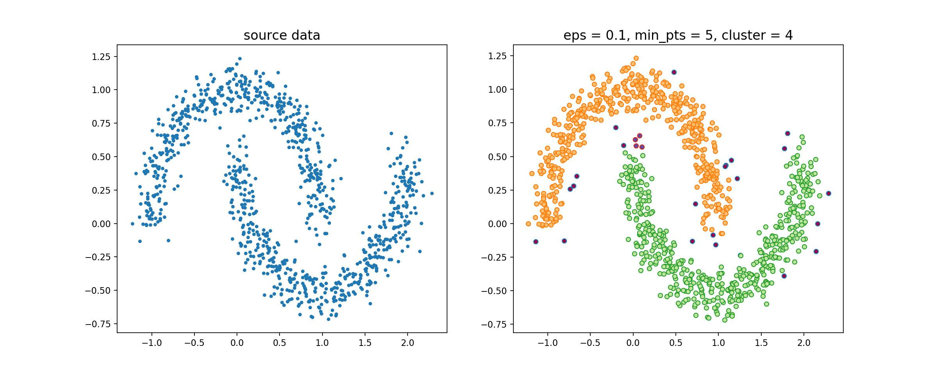
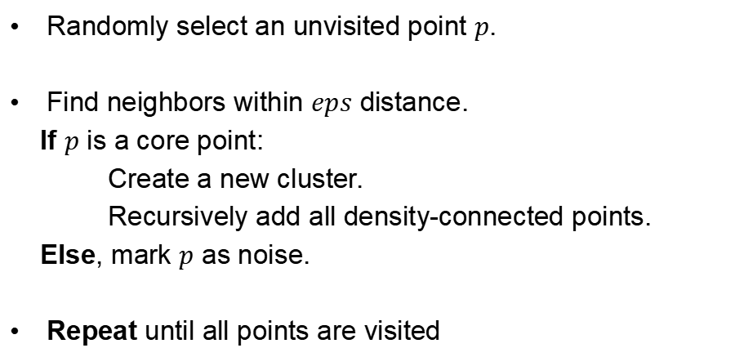
Density-Based Spatial Clustering of Applications with Noise (DBSCAN)
Algorithm:
Randomly select an unvisited point $p$.
Find neighbors within $eps$ distance.
If $p$ is a core point:
Create a new cluster.
Recursively add all density-connected points.
Else, mark $p$ as noise.
Repeat until all points are visited
Figure:Clustering by DBSCAN
This algorithm is particularly suited to deal with large datasets with noise, and is able to identify clusters with different sizes and shapes.

Slide 17
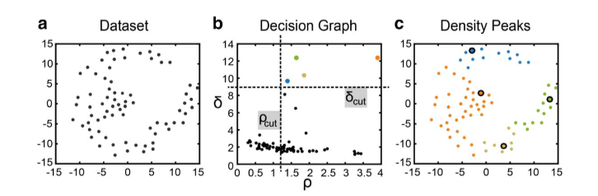
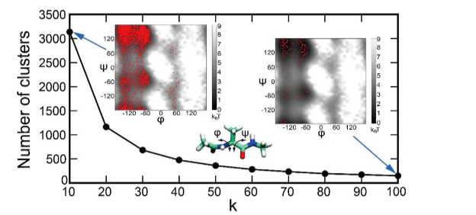
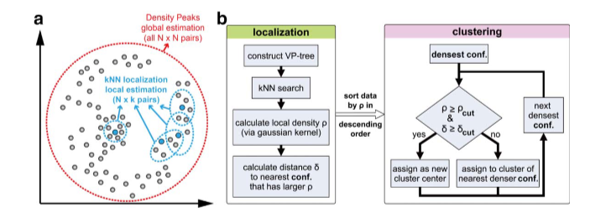

Application for clustering algorithm in computational chemistry
A density-based adaptive-resolution clustering algorithm APLoD for analyzing large-scale MD trajectories.
DOI: 10.1002/jcc.24664

Slide 18


Application for clustering algorithm in computational chemistry
Automatically reduces the statistical error within all clusters by adaptively generating smaller clusters in denser regions and larger clusters in sparse regions
Applied in the construction of MSMs for complex processes
DOI: 10.1002/jcc.24664

Slide 19


Application for clustering algorithm in computational chemistry
Schematic of the workflow for adsorption energy distributions
Discovering new catalyst candidates for the conversion of CO2 to methanol utilizing data-driven methodologies such as MLFFs and hierarchical clustering
Obtain a novel material descriptor, adsorption energy descriptor, AED, which offers a more effective representation of the complex nature of heterocatalysts compared to standard methods.
Hierarchical clustering of the materials, based on the Wasserstein distances.
DOI: 10.1038/s41524-025-01664-9

Slide 20



Application for clustering algorithm in computational chemistry
A GPU powered k-centers clustering algorithm that utilizes the triangle inequality with an improved running time of O(k² + kf_{avg}N)
DOI: 10.1002/jcc.23110

Slide 21



Application for clustering algorithm in computational chemistry
Be useful for high-throughput analysis of simulation data in future
DOI: 10.1002/jcc.27470

Slide 22
Unsupervised Learning

Slide 23



Unsupervised Learning
Unsupervised learning is a type of machine learning that learns the statistical patterns or internal structures of data from unlabeled data.
Tasks:
Usage:
Clustering
Dimensionality Reduction
Probability Model Estimation
Data Analysis
Data Preprocessing for Supervised Learning
Function Model:
$$x∈X$$
$$𝓏=g_{θ}(x)$$
$$𝓏∈Z$$
Matrix for dataset, rows for features and columns for samples
$$X=\left[\begin{matrix}x_{11} & ⋯ & x_{1N} \\ ⋮ & ⋱ & ⋮ \\ x_{M1} & ⋯ & x_{MN}\end{matrix}\right]$$

Slide 24
Unsupervised Learning
Dimensionality Reduction
Converting samples from high-dimensional space to low-dimensional space
Better representation of the data structure
Better representation of the relationships between samples
Figure:Example of Dimensionality Reduction

Slide 25

Principal Component Analysis (PCA)
PCA can be defined as an orthogonal projection of the data onto a low-dimensional linear space, called the principal subspace, such that the variance of the projected data is maximized (Hotelling, 1933). Equivalently, it can also be defined as the linear projection such that the average projection cost is minimized, that is, the minimum error theory. The average projection cost is the average squared distance between exponential data points and their projections (Pearson, 1901).
Obtain Principal Component, accelerate training efficiency without much loss of model quality

Slide 26



Principal Component Analysis (PCA)
Algorithm:
Input: Dataset $X$
Output: Dimensionality reduced dataset $XnewW$
Calculate X average $Xmean$ by columns, the let $Xnew = X – Xmean$
Compute Covariance Matrix of $Xnew$ and denote it as $Cov$
Calculate eigenvalues and eigenvectors of $Cov$
Sort eigenvalues in descending order and choose the top k eigenvectors
Let the corresponding k eigenvectors used as column vectors to form the eigenvector matrix $W$
Calculate the projection of the dataset $Xnew$ to the selected feature vector, $XnewW$

Slide 27



Principal Component Analysis (PCA)
Evaluation Methods
Projected mean squared error of each sample
$$min\frac{1}{m}\sum_{j=1}^{m}{{\left\|x_{i}−x_{i,approx}\right\|}^{2}}$$
Total variation of the data
$$\frac{1}{m}\sum_{j=1}^{m}{{\left\|x_{i}\right\|}^{2}}$$
$$\frac{min\frac{1}{m}\sum_{j=1}^{m}{{\left\|x_{i}−x_{i,approx}\right\|}^{2}}}{\frac{1}{m}\sum_{j=1}^{m}{{\left\|x_{i}\right\|}^{2}}} ≤ ε$$
?

Slide 28



Locally Linear Embedding (LLE)
Assuming the data is linear in small localities first
$$x_{1}=w_{12}x_{2}+w_{13}x_{3}+w_{14}x_{4}$$
We hope that the corresponding low-dimension projection of $x1$,
denote as $x’1$ preserves the same linear relationship.
$${x′}_{1}≈w_{12}{x′}_{2}+w_{13}{x′}_{3}+w_{14}{x′}_{4}$$
The weight coefficient $w_{12}$, $w_{13}$, $w_{14}$of the linear relationship before and after projection is as much as possible unchanged or minimal change.
The linear relationship only works in the vicinity of the sample, and the samples far away from the sample have no effect on the local linear relationship, so the complexity of dimensionality reduction is reduced a lot

Slide 29



Locally Linear Embedding (LLE)
Algorithm:
Input: Dataset $X$
Output: Dimensionality reduced dataset $Xnew$
Compute the k nearest neighbors to xi, using the Euclidean distance metric
Compute Covariance Matrix $Z_{i}=(x_{i}−x_{j}){(x_{i}−x_{j})}^{T}$, and the corresponding weight coefficient vector $Wi$
$$W_{i}=\frac{Z_{i}^{−1}1_{k}}{{1_{k}^{T}Z}_{i}^{−1}1_{k}}$$
Form the weight coefficient matrix $W$ by weight coefficient vectors , calculate matrix $M=(I−W)(I−W)T$
Compute the first d+1 eigenvalues of the matrix $M$, and compute the eigenvectors corresponding to these d+1 eigenvalues$\{y1,y2,…,y_{d+1}\}$
The matrix spanned from the second eigenvector to the d+1th eigenvector is the output

Slide 30

Unsupervised Learning
Probability Model Estimation
Determining the parameters of a statistical model that best describe the observed data, assuming the data follows a specific probability distribution
Bayes’ Theorem
$$P\left(θ | X\right)=\frac{P\left(θ | X\right)P(θ)}{P(X)}$$
Figure:Example of Probability Model Estimation

Slide 31


Markov Chain Monte Carlo (MCMC)
Monte Carlo method: A method of approximate numerical computation by random sampling from a probabilistic model
Core: Random sampling
Algorithm:
Accept-Reject Sampling Method
Input: probability density function of target probability distribution, $p(x)$
Output: Random samples that obey the target probability distribution
Parameter: number of samples, $n$

Slide 32



Markov Chain Monte Carlo (MCMC)
Markov Chain: A mathematical system that undergoes transitions from one state to another within a finite or countable set of possible states
Markov Property
$$P\left(X_{t} | X_{0},X_{1},…,X_{t−1}\right)=P\left(X_{t} | X_{t−1}\right), t=1,2,…$$
Types of Markov Chains
Discrete-Time Markov Chains (DTMC)
Continuous-Time Markov Chains (CTMC)
Transition Kernel
Stochastic Matrix
$$P\left(x,A\right)= ∫_{A}p\left(x,y\right)ⅆy$$
$$P=\left[\begin{matrix}p_{11} & p_{12} & \begin{matrix}p_{13} & ⋯\end{matrix} \\ p_{21} & p_{22} & \begin{matrix}p_{23} & ⋯\end{matrix} \\ \begin{matrix}p_{31} \\ ⋯\end{matrix} & \begin{matrix}p_{32} \\ ⋯\end{matrix} & \begin{matrix}\begin{matrix}p_{33} \\ ⋯\end{matrix} & \begin{matrix}⋯ \\ ⋯\end{matrix}\end{matrix}\end{matrix}\right]$$
$$P\left(X_{t}=A | X_{t−1}=x\right)=P\left(x,A\right)$$
Sometimes, the probability density function $p\left(x,∙\right)$, also seem as transition kernel.

Slide 33



Markov Chain Monte Carlo (MCMC)
Basic Steps for MCMC
(1) First, construct a Markov chain that satisfies the ergodic theorem on the state space $S$ of the random variable $x$, so that its stationary distribution is the target distribution $p(x)$.
(2) Start from a certain point $x0$ in the state space, use the constructed Markov chain to perform a random walk to generate a sample sequence $x0,x1,…,xt,…$.
(3) Apply the ergodic theorem of the Markov chain. Determine positive integers $m$ and $n$ $(m < n)$to obtain the sample set $\{x_{m+1},x_{m+2},…,x_{n}\}$, and calculate the mean (ergodic mean) of the function $f(x)$
$$\hat{E}f=\frac{1}{n−m}\sum_{i=m+1}^{n}{f\left(x_{i}\right)}$$
Several important issues:
(1) How to define the Markov chain to ensure that the conditions of the Markov chain Monte Carlo method are met.
(2) How to determine the convergence step number $m$ to ensure the unbiasedness of sample sampling.
(3) How to determine the iteration step number $n$ to ensure the accuracy of the ergodic mean calculation.

Slide 34

Markov Chain Monte Carlo (MCMC)
Metropolis-Hastings Algorithm
Transition Kernel
$$p\left(x,x′\right)=q\left(x,x′\right)α\left(x,x′\right)$$
Proposal distribution
Acceptance distribution
Figure:Example of Metropolis-Hastings Algorithm

Slide 35




Markov Chain Monte Carlo (MCMC)
Metropolis-Hastings Algorithm
Input: Target probability distribution's density function $p(x)$, function $f(x)$;
Output: Random samples $\{x_{m+1},x_{m+2},…,x_{n}\}$ of $p(x)$, function sample mean $f_{mn}$;
Parameters: Number of convergence steps $m$, number of iteration steps $n$.
(1) Arbitrarily select an initial value $x0$
(2) execute the loop
(a) Let the state $x_{i−1}=x$, and randomly draw a candidate state $x′$according to the
proposal distribution $q(x, x′)$.
(b) Calculate the acceptance probability
$$α\left(x,x′\right)=min\left\{1,\frac{p\left(x^{′}\right)q(x^{′},x)}{p\left(x\right)q(x,x′)}\right\}$$
(c) Randomly draw a number $u$ from the interval $(0, 1)$ according to the uniform distribution.
If $μ≤α\left(x,x′\right)$, then the state $xi = x’$; otherwise, the state $xi= x$.
(3) Obtain the sample set $\{x_{m+1},x_{m+2},…,x_{n}\}$
Calculate
$$f_{mn}=\frac{1}{n−m}\sum_{i=m+1}^{n}{f\left(x_{i}\right)}$$

Slide 36
Markov Chain Monte Carlo (MCMC)
Gibbs sampling
The basic approach is to define full conditional probability distributions from the joint probability distribution, and then sample from these full conditional probability distributions sequentially to obtain a sequence of samples.
Gibbs sampling is used for the sampling and estimation of the joint distribution of multiple variables.
Figure:Example of Gibbs sampling

Slide 37




Markov Chain Monte Carlo (MCMC)
Gibbs sampling
Input: Target probability distribution's density function $p(x)$, function $f(x)$;
Output: Random samples $\{x_{m+1},x_{m+2},…,x_{n}\}$ of $p(x)$, function sample mean $f_{mn}$;
Parameters: Number of convergence steps $m$, number of iteration steps $n$.
Initialization: Give the initial sample $x^{(0)} = (x_{1}^{(0)},x_{2}^{(0)},…,x_{k}^{(0)})T$
Loop
Suppose the sample at the end of the $(i−1)$-th iteration is $x^{(i−1)} = (x_{1}^{(i−1)},x_{2}^{(i−1)},…,x_{k}^{(i−1)})T$,then the $i$-th iteration performs the following steps:
(I)Sample $x_{1}^{(i)}$ from the full conditional distribution $p\left(x_{1} | x_{2}^{(i−1)},…,x_{k}^{(i−1)}\right)$
(j)Sample $x_{j}^{(i)}$ from the full conditional distribution $p\left(x_{j} | x_{1}^{(i)},…,x_{j−1}^{(i)},x_{j+1}^{(i−1)}…,x_{k}^{(i−1)}\right)$
(k)Sample $x_{k}^{(i)}$ from the full conditional distribution $p\left(x_{k} | x_{1}^{(i)}, …,x_{k}^{(i)}\right)$
Obtain the $i$-th iteration value
Obtain the sample set
Calculate
$$x^{(i)} = (x_{1}^{(i)},x_{2}^{(i)},…,x_{k}^{(i)})T$$
$$\{x_{m+1},x_{m+2},…,x_{n}\}$$
$$f_{mn}=\frac{1}{n−m}\sum_{i=m+1}^{n}{f\left(x_{i}\right)}$$

Slide 38


Application for unsupervised algorithm in computational chemistry
Unsupervised manifold embedding to encode molecular quantum information for supervised learning of chemical data
Originated from our earlier studies of evaluating molecular interactions with local hardness and softness quantities within the CDFT framework
Unsupervised learning of manifold embedding and quantum mechanical evaluation of electronic quantities within the framework of the HSAB principle and CDFT
Illustration of dimensionality reduction of molecular surface
DOI: 10.1038/s42004-024-01217-z

Slide 39

Application for unsupervised algorithm in computational chemistry
Deep-learning results by cut Hirshfeld surface MEMS of 133 molecules
DOI: 10.1038/s42004-024-01217-z

Slide 40


Application for unsupervised algorithm in computational chemistry
A data-driven generative strategy to avoid reward hacking in multi-objective molecular design
Workflow of DyRAMO (Dynamic Reliability Adjustment for Multiobjective Optimization
The concept of applicability domain (AD) and difficulties of multi-objective optimization incorporating multiple ADs.
DOI:10.1038/s41467-025-57582-3

Slide 41


Application for unsupervised algorithm in computational chemistry
The processes of adjusting reliability levels by Bayesian optimization (BO) and random exploration in DyRAMO (Dynamic Reliability Adjustment for Multi-objective Optimization).
Result of the molecular designs using DyRAMO.
DOI:10.1038/s41467-025-57582-3

Slide 42


Application for unsupervised algorithm in computational chemistry
Removal of similar molecules across datasets and rediscovered examples in the removed molecules.
Conclusion
Effects of prioritization on adjustment of reliability levels.
Overcome the limitations of molecular designs that depend on training data
Enable reliable molecular design in a broader chemical space
DOI:10.1038/s41467-025-57582-3

Slide 43


Application for unsupervised algorithm in computational chemistry
Classifying soft self-assembled materials via unsupervised machine learning of defects
A “defectometer” by constructing a data-driven analysis strategy based on SOAP description and unsupervised clustering (PAMM)
Classification of supramolecular polymers based on the structural/dynamical features of their molecular motifs
Comparing variants of supramolecular polymers
DOI: 10.1038/s42004-022-00699-z

Slide 44


Application for unsupervised algorithm in computational chemistry
Comparing 1D assembiles
Comparing 2D assembiles
DOI: 10.1038/s42004-022-00699-z

Slide 45


Application for unsupervised algorithm in computational chemistry
Similarity classification of soft, dynamic supramolecular materials
Comparison and classification of soft self-assembled materials based on the structural dynamics of the internal molecular environments that surround their constitutive monomers.
Comparing 3D assembiles
This workflow is powerful for multiple reasons.
(i) It does notbuild on any a priori knowledge.
(ii) Holding a great potential to unify supramolecular materials.
(iii)quantitatively classify dynamic assemblies that are different from each other
Overcoming standard classification approaches based on a priori assumptions on the features of the assemblies
DOI: 10.1038/s42004-022-00699-z

Slide 46
Thank You!

